Slide 1
Chapter 2. First-Order Ordinary Differential Equations
Chuan-Ching Sue
Dept. of Computer Science and Information Engineering,
National Cheng Kung University

Slide 2
Review
上周
若發現 則檢查
除以
除以
除以
除以

Slide 3
Integrating Factor Examples
今天
例:

Slide 4
Integrating Factor Examples
例:

Slide 5
Integrating Factor Examples
(1) (2)

Slide 6
Integrating Factor Examples
(1): (2):
(令t=sinx)

Slide 7
Integrating Factor Examples

Slide 8
Integrating Factor Examples
例:
(分離變數法可解)
除以-N

Slide 9
Integrating Factor Examples

Slide 10
Integrating Factor Examples

Slide 11
Separation of Variables
2.2分離變數法(補充)
例:
除以M

Slide 12
Separation of Variables
課本答案

Slide 13
Separation of Variables
除以

Slide 14
Separation of Variables Example
例:

Slide 15
First-Order O.D.E.
2.3複習:一階O.D.E.(線性 OR 非線性)
一階線性O.D.E.(常微分)
Homogeneous 齊性
Non- Homogeneous 非齊性

Slide 16
First-Order O.D.E. (homogeneous)
Case (1):
(令 C = )

Slide 17
First-Order O.D.E.(Non-homogeneous)
Case (2):

Slide 18
First-Order O.D.E.(Non-homogeneous)

Slide 19
First-Order O.D.E.(Non-homogeneous)

Slide 20
First-Order O.D.E.(Non-homogeneous)

Slide 21
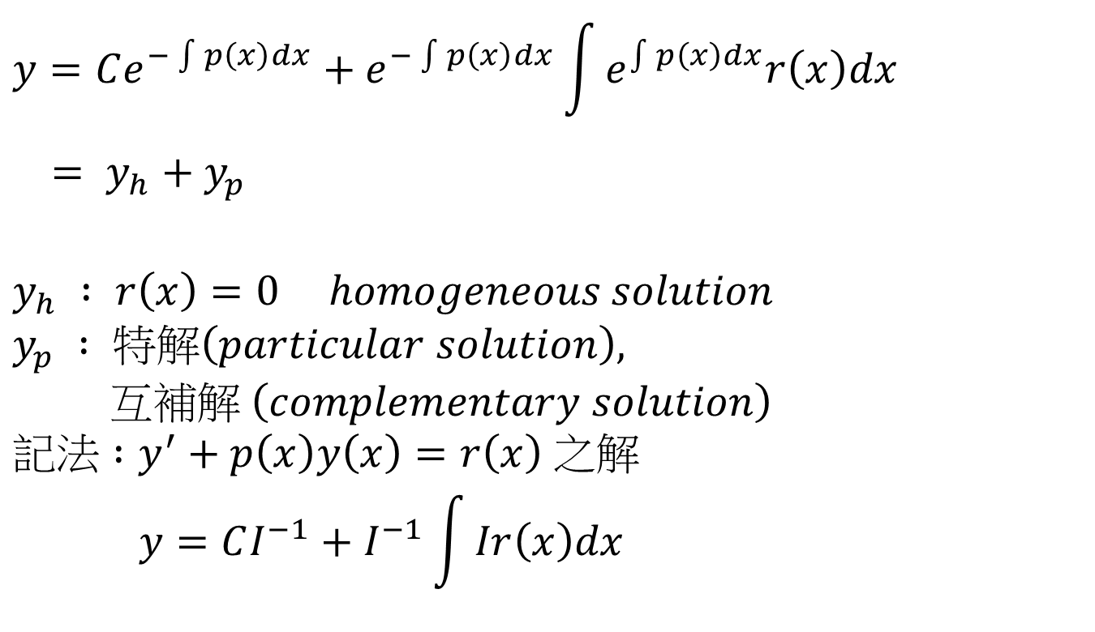
First-Order O.D.E.(Non-homogeneous)
$$y=Ce^{−\int{p\left(x\right)dx}}+e^{−\int{p\left(x\right)dx}}\int{e^{\int{p\left(x\right)dx}}r\left(x\right)dx}$$
$$= y_{h}+y_{p}$$
$$y_{h} : r\left(x\right)=0 homogeneous solution$$
$$y_{p} : 特解\left(particular solution\right),$$
$$互補解 \left(complementary solution\right)$$
$$記法 :y^{′}+p\left(x\right)y\left(x\right)=r\left(x\right) 之解$$
$$y=CI^{−1}+I^{−1}\int{Ir\left(x\right)dx}$$

Slide 22
First-Order O.D.E.(Non-homogeneous)
例:
(1)
(2) Theorem:
又 滿足非齊性方程式

Slide 23
First-Order O.D.E.(Non-homogeneous)
Proof:

Slide 24
Non-homogeneous Example
例:

Slide 25
Chapter 3. Higher-Order Differential Equations
Chuan-Ching Sue
Dept. of Computer Science and Information Engineering, National Cheng Kung University

Slide 26
First-Order O.D.E.
Case (1):
Homogeneous
常係數
的部分必為指數函數

Slide 27
First-Order O.D.E.
例:

Slide 28
Higher-Order O.D.E.
例:

Slide 29
Higher-Order O.D.E.
Case (1):
例:
例:

Slide 30
Higher-Order O.D.E.
Case (2):

Slide 31
Higher-Order O.D.E. Examples
例:
例:

Slide 32
Higher-Order O.D.E.
補充 :

Slide 33
Higher-Order O.D.E.
定義:

Slide 34

Higher-Order O.D.E.
$\left(D−λ_{2}\right)y=z\left(x\right)=k_{1}e^{−λ_{1}x}$
$y^{′}−λ_{2}y=k_{1}e^{−λ_{1}x}$
$y=CI^{−1}+I^{−1}\int{Irdx}$
$I=e^{\int{λ_{2}dx}}=e^{λ_{2}x}$

